Slide 1
BIOS27816: Population biology of infectious diseases of global health concern
Introduction to Sequencing for Global Health
UChicago Center in Paris
Paris, France
January 2024

Slide 2
What is sequencing?

Slide 3
What is sequencing?
Sequencing determines the order of the four bases (A, T, G and C) that make up DNA
The first DNA sequences were obtained in the early 1970s
Requires both laboratory and bioinformatics skills!

Slide 4
The Human Genome Project
Began October 1990 and completed April 2003
Researchers aimed to decipher the human genome in three major ways:
Determining the sequence of all the bases in the human genome
Mapping the locations of genes for major sections of our chromosomes
Producing linkage maps, so inherited traits (e.g. for genetic disease) can be tracked over generations
The sequence is derived from the DNA of several volunteers
Cost $2.7 billion!
Mainly used Sanger sequencing technology

Slide 5
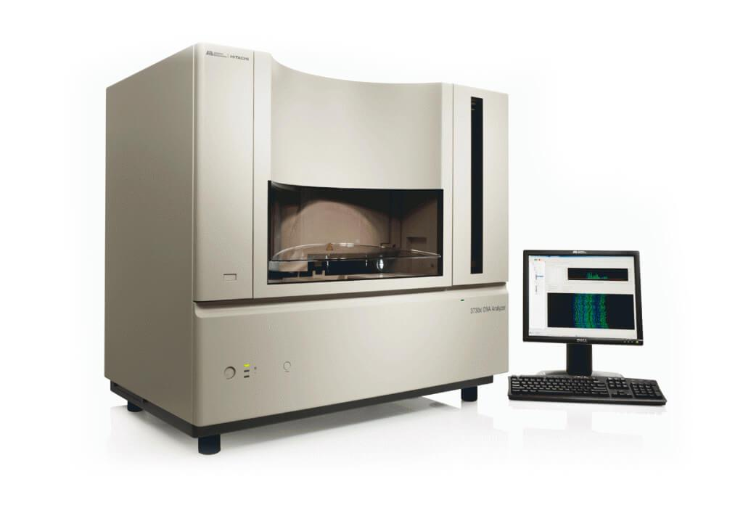
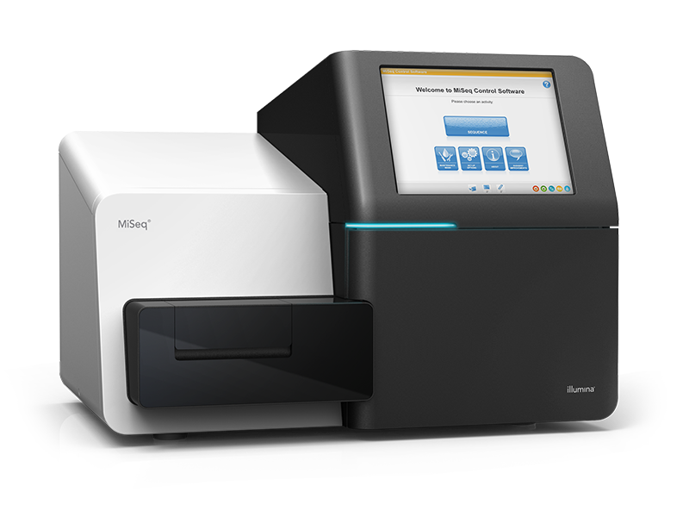
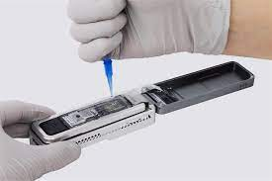
What is sequencing?
Sanger
Illumina (short-read)
Nanopore (long-read)

Slide 6
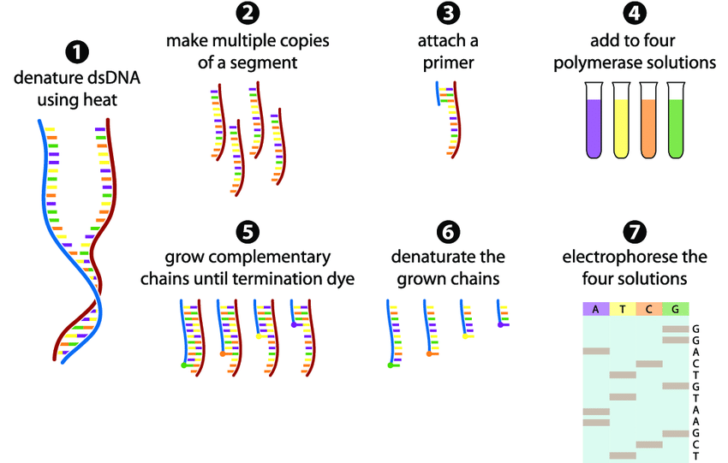
Sanger Sequencing
The DNA sample is divided into four separate reactions, containing all four of the standard deoxynucleotides (dATP, dGTP, dCTP and dTTP) and a DNA polymerase (which attached the dNTPs)
To each reaction is added only one dideoxynucleotides (ddATP, ddGTP, ddCTP, or ddTTP)
Four separate reactions are needed in this process to test all four ddNTPs
The ddNTP stops the DNA polymerase when it comes to a base of that type (e.g. A, T, G, C)
The fragments are then run on a gel. The smallest move through the gel furthest and the ‘ladder’ shows the sequence of the DNA
https://www.youtube.com/watch?v=FvHRio1yyhQ&t=171s

Slide 7
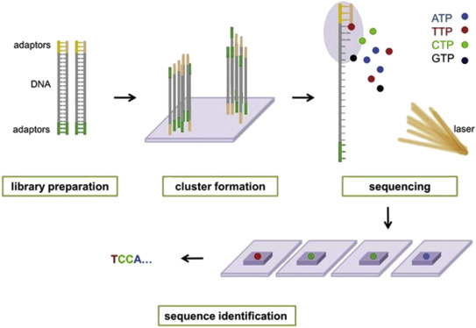
Illumina (short read) Sequencing
Sequencing by synthesis
‘Short read’ technology – DNA is cut up into 200-600 bp chunks
The DNA is amplified, so there are lots of copies of the chunks
They are denatured, then fluorescent complimentary bases are attached
These fluoresce different colours, which is recorded, and the sequence is identified
https://www.youtube.com/watch?v=womKfikWlxM

Slide 8
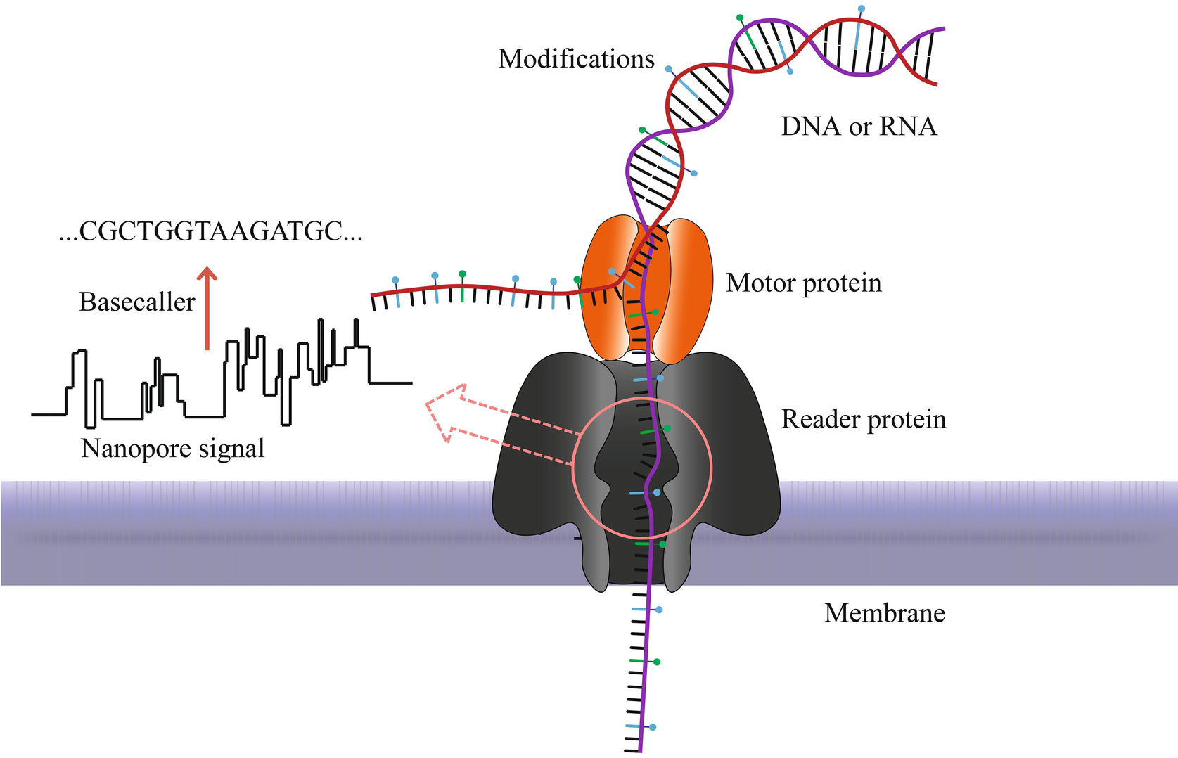
Nanopore (long read) Sequencing
Long read’ technology
A DNA library is prepared (proteins are added)
Nucleic acids are passed through a protein nanopore
As the different bases move through the nanopore, it creates a different electrical signal
These resulting changes in the electrical signal is decoded to provide the specific DNA or RNA sequence
https://www.youtube.com/watch?v=RcP85JHLmnI&t=18s

Slide 9
Where do these sequences go once we have them?
Nextclade: genome quality and curation
GISAID: Global Initiative on Sharing All Influenza Data
NCBI: National Center for Biotechnology Information

Slide 10
COVID-19 has hastened the expansion of pathogen genomic sequencing in Africa
Tegally et al. 2022. Science.

Slide 11
COVID-19 has hastened the expansion of pathogen genomic sequencing in Africa
Tegally et al. 2022. Science.

Slide 12
COVID-19 has hastened the expansion of pathogen genomic sequencing in Africa
Tegally et al. 2022. Science.

Slide 13
COVID-19 has hastened the expansion of pathogen genomic sequencing in Africa
Tegally et al. 2022. Science.

Slide 14
COVID-19 has hastened the expansion of pathogen genomic sequencing in Africa
Tegally et al. 2022. Science.

Slide 15
COVID-19 has hastened the expansion of pathogen genomic sequencing in Africa
Tegally et al. 2022. Science.

Slide 16
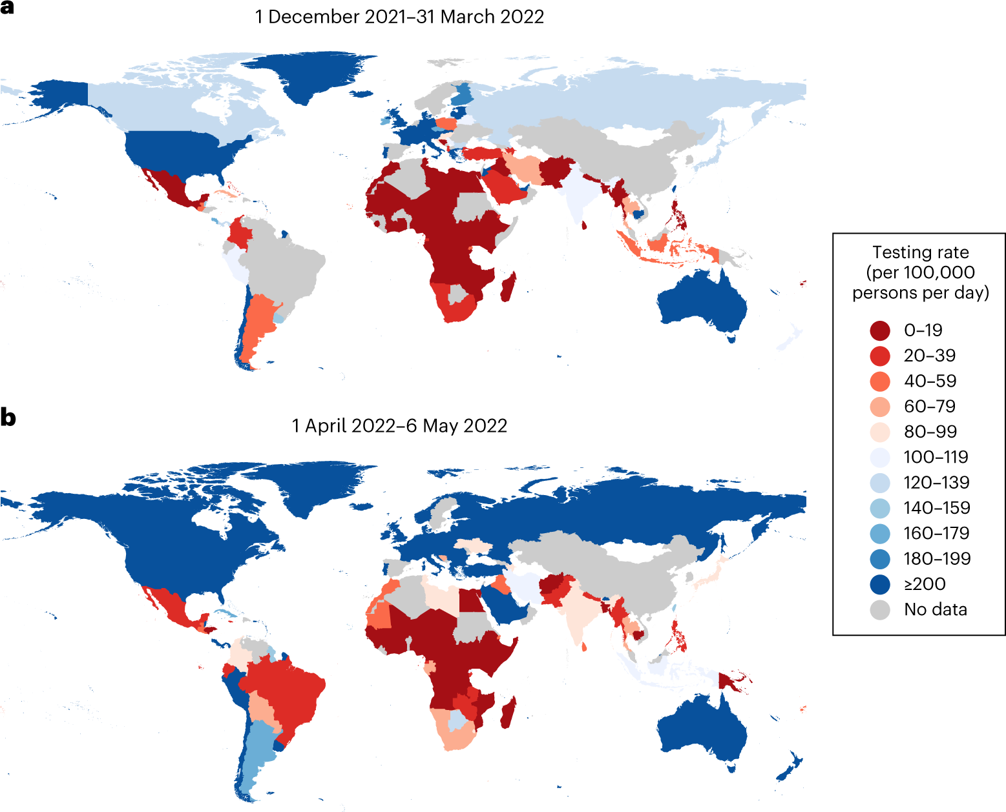
But there are still many, many gains to be made!
Han et al. 2023. Nature Genetics.

Slide 17
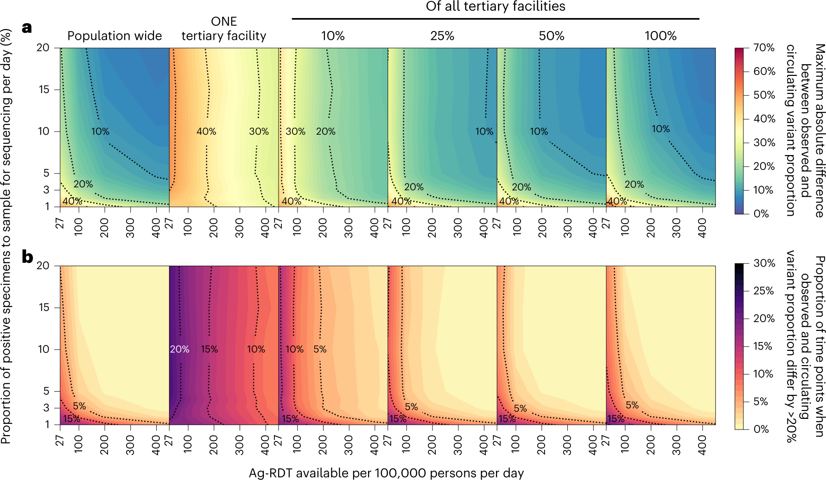
Han et al. 2023. Nature Genetics.

